Slide 1
An exploration of Education and Unemployment Indicators
Samd Guizani

Slide 2
Dataset(s)
The chosen dataset is:
World Development Indicators Dataset

Slide 3
Motivation
World Development Indicators data presents data about:
Population Education
Unemployment
These indicators can be identified by key words search in column ‘IndicatorName’
The investigation is about assessing unemployment vs. level of education (primary, secondary, tertiary) in a selection of countries
In addition, differences between male and female are evaluated.
Insights from such studies can support decision in the field of education policies and programs for male/female equality

Slide 4
Research Question(s)
How does the level of education influences unemployment? Evaluate how the situation evolved over time in 4 countries:
France and Italy, 2 Western European countries
Tunisia and Egypt, 2 Northern African countries
Is there a difference between male and female?

Slide 5
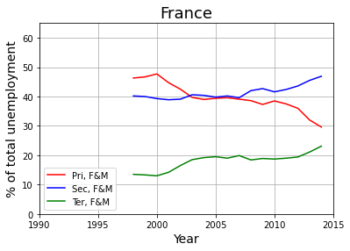
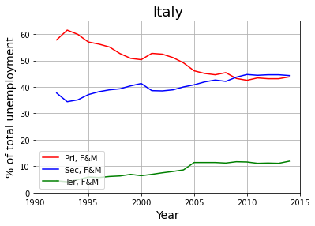
Findings (1/4) – W. European countries (Male and Female combined)
Highly similar Unemployment trends in France and Italy over time:
Population with tertiary education (green) are less likely to be unemployed.
Between 2000 and 2015, unemployment proportion of tertiary educated population tends to slightly increase.
Unemployment proportion of primary educated population (red) tends to decrease.
Unemployment proportion of people with secondary education (blue) remains more or less stable over time.

Slide 6
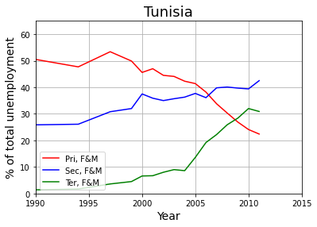
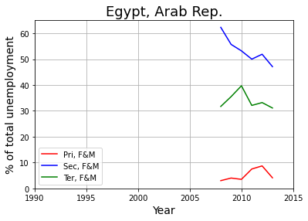
Findings (2/4) – N. African countries (Male and Female combined)
In Tunisia:
Similar trends as France and Italy are observed. However, amplitude of changes is larger.
From 2000 to 2012, unemployment proportion of people with tertiary education has greatly increased
Within same period, unemployment proportion of people with primary education has drastically decreased
In Egypt (Less data available: 2008 to 2013):
Surprisingly, unemployment proportion of population with secondary education is the highest, followed by unemployment proportion of people with tertiary education
Primary educated population is the least likely to be affected by unemployment

Slide 7
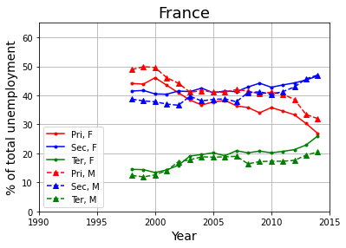
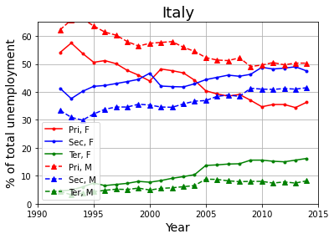
Findings (3/4) – W. European countries (Differences between Male & Female)
Women with secondary or tertiary education are more affected by unemployment than men (particularly visible for Italy).
Situation is the opposite for primary educated population: in this population, higher proportion of men is affected by unemployment.
For tertiary educated population, the unemployment gap between male and female tends to increase.

Slide 8
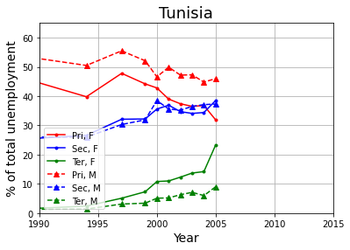
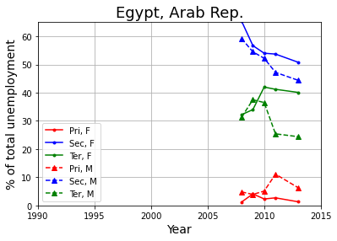
Findings (4/4) – N. African countries (Differences between Male & Female)
Situation in the 2 Northern African countries is comparable to the 2 Western European countries:
In tertiary and secondary educated population, women are more affected by unemployment than men
In primary educated population, men are more affected by unemployment than women
Male/Female gap tend to increase in tertiary educated population

Slide 9
Acknowledgements
No feedback received on this work.

Slide 10
References
Work done on my own / No references.

